Slide 1
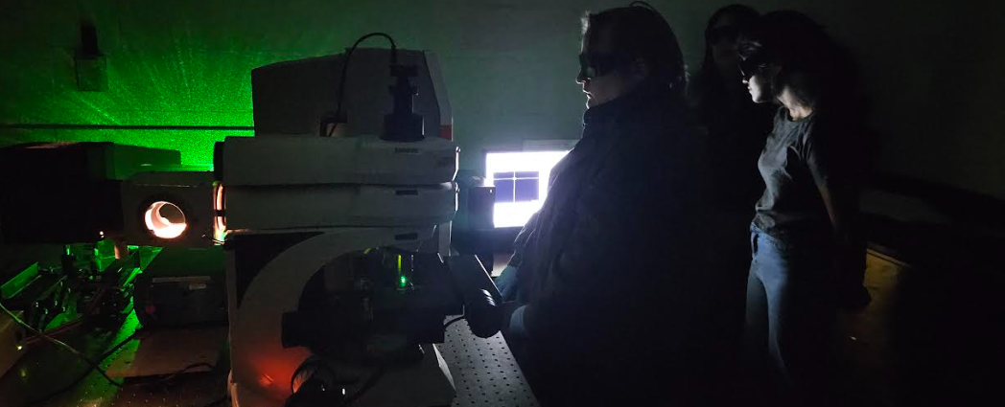
Raman Groups
Optional: If some people would like to do another round, we can. We’ll probably lump it into one session though, since I doubt more than half of you would want to. Let’s see how your data looks.
MOKE
Tuesdays 4:30 in White 434
Julie thinks the sample holder will be ready next week. If so, after an alignment, I think we’re ready to try measuring!

Slide 2
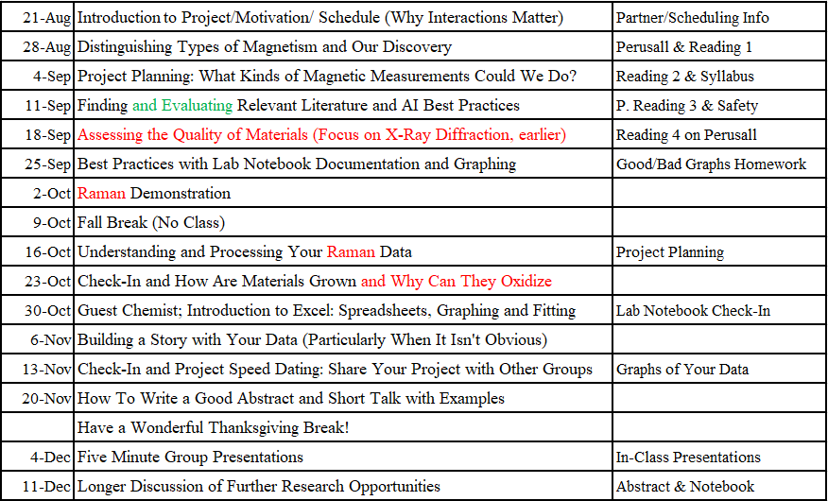
Submit Lab Notebooks Today Late is better than never but don’t put off too long. Late penalty increases with time.
We are here
Today
2 weeks

Slide 3
Every graphing program has pros and cons
Roughly increasing in difficulty:
Excel/Google Sheets: easy, normally accessible, graphing has some clunky features (Best 4 novice)
Desmos.com: fairly easy, free, graphs as you go which is nice (Good for novices feeling slightly adventurous)
Origin: Free for 6 months, user-friendly, point-and-click graphical interface for plotting and statistical analysis
MatLab is a more powerful (not free), code-based environment for numerical computation and advanced modeling
Python: free, initial setup confusing, widely used in science, but getting used to using takes more time than we have in this 1-credit hour class (department is debating adding a 1 credit hour computation class for this purpose. Would you have liked that?)
Notes:
Google Sheets seems VERY similar to Excel, but there may be some small differences

Slide 4
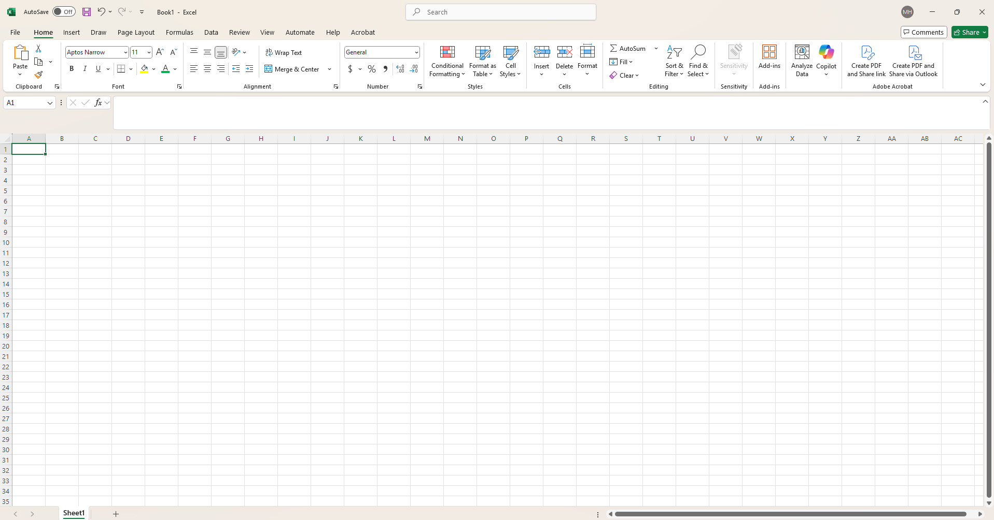
Excel can be used for information storing, calculations, graphing, fitting
You can easily store related information together by either using different columns or sheets

Slide 5
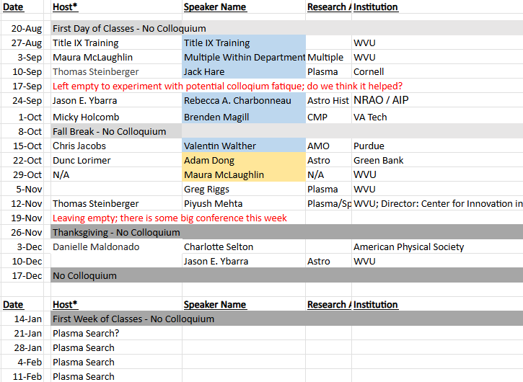
Ways I Use Excel: Scheduling
Such as class scheduling and colloquia
Wednesdays 2:30 (check them out!)

Slide 6
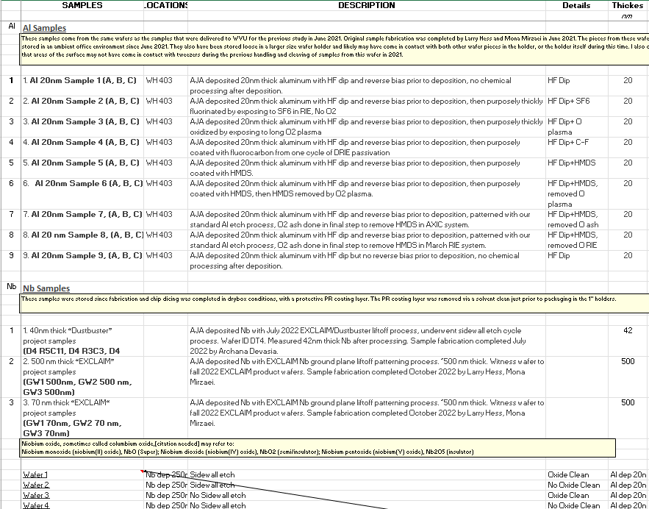
Storing information on related items
Some details on a few of our NASA samples
You can also have columns for what you have measured and brief interpretations

Slide 7
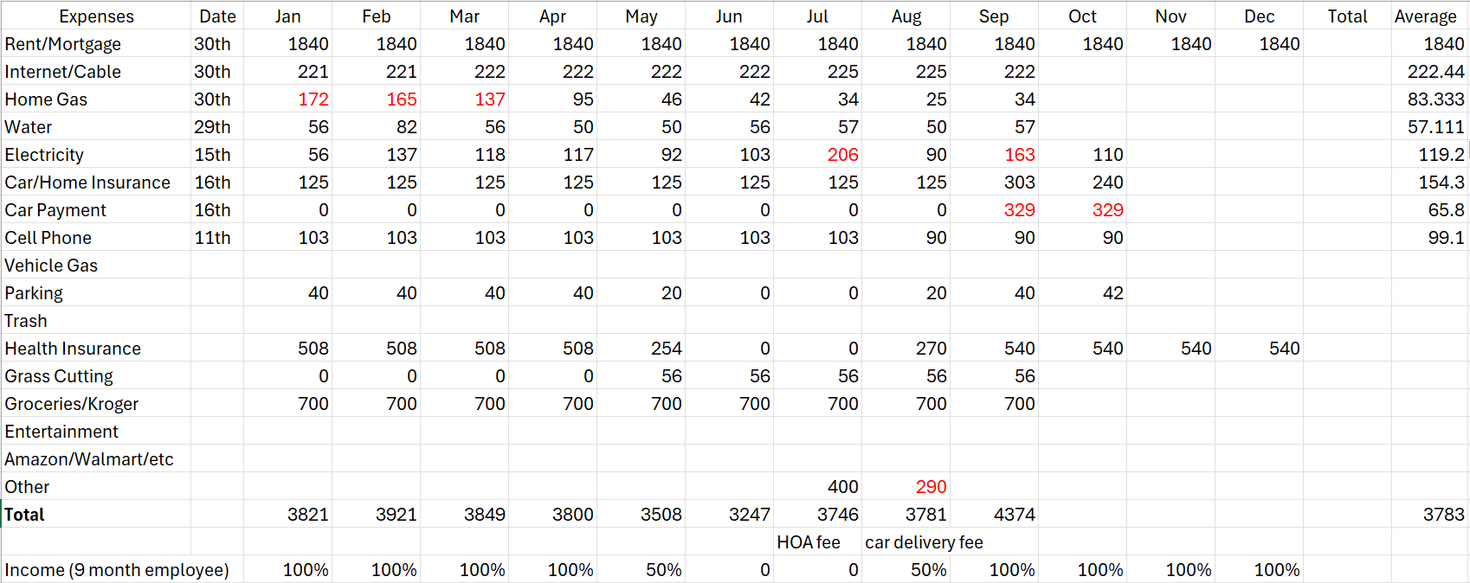
Personal Finance
You can use both to budget and then to check that you spent what you planned to, so that you can make adjustments if not
You can break down rows as much or as little as you like. Entertainment could be broken down into restaurants, bars, gaming, etc. if you needed to evaluate how to reduce costs

Slide 8
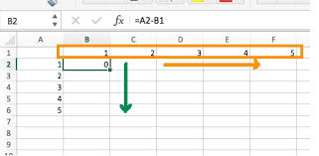
Common uses
Click on boxes and extend to copy entries
Click on two adjacent boxes to start a sequence. Even works for dates.
=A3 + A4 + A5 to sum up specific values
=SUM(A3:A5) would give the same result
=AVG(A3:A5) to average a set of numbers
=MIN (A3:A5) to identify min of numbers (same with max/median/standard deviation)
Subtracting one column from another column (or row)
Notes:
For example, if you had 5 & 15, then get 25, 35 etc

Slide 9
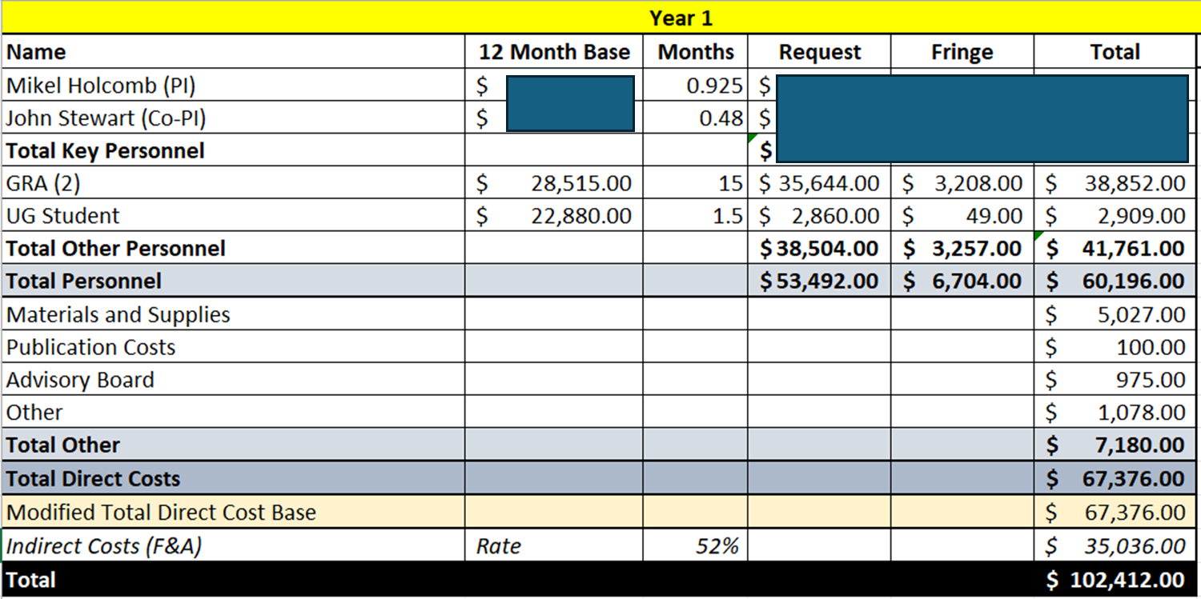
Grant Budgetting Note: Grad students in sciences get paid to be researchers or teaching assistants
Benefits
Indirect costs at a university cover university-wide expenses not tied to a specific student or grant, including facilities and administrative support (like building maintenance, utilities, and IT). The rate is negotiated with the government.
Notes:
Admittedly, they aren’t paid much, but you have to keep in mind that school is an investment to set yourself up to get higher pay jobs.

Slide 10
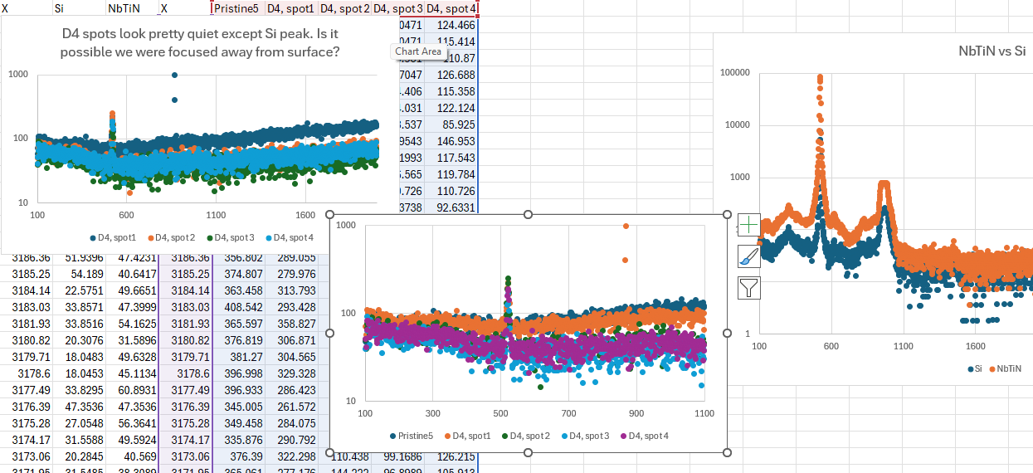
I will walk you through several aspects of how you might want to analyze this data in Excel

Slide 11
Video of Lorentzian Fitting in Excel
Microsoft Excel: Fitting data to a Lorentzian Peak (how to plot one) – Note that you’ll want the fit to be a line not points.
You could do similarly with other kinds of fitting too
Fitting to Lorentzian with R: https://youtu.be/kIgnjQymiVM

Slide 12
Rest of Class
Guest speaker Brian Dolinar from Chemistry (you’ve met many from physics)

